Slide 1
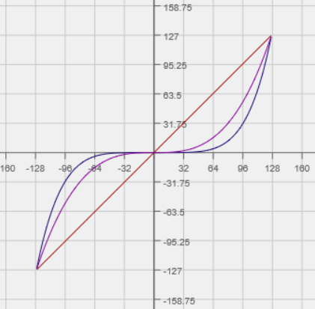
Polynomial Chassis Driver Control
Ray Sun Damien High School Robotics 2016
VRC 6526D MRS. Maricic

Slide 2
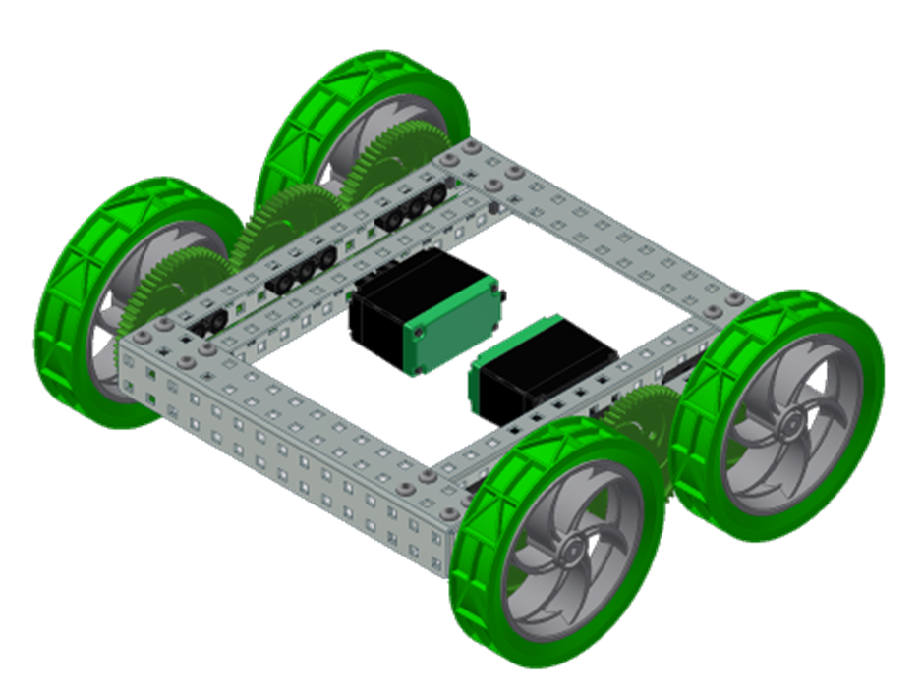
This presentation assumes basic knowledge of ROBOTC and driver-control programming.
As an example for explication, a simple two-motor chassis will be used.

Slide 3
Theory
Why MOTOR[] = VEXRT() is Inefficient

Slide 4
The Problem of Precise Driving
Normal chassis control code directly assigns the motors the value of the joystick.
If both joysticks are pushed to maximum forward position (127), the Cortex makes the following substitution and the motors run at full speed in the positive direction.

Slide 5
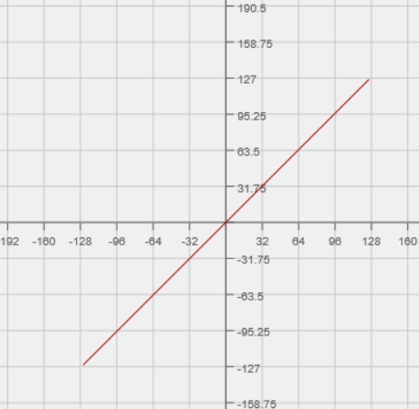
The Problem of Precise Driving
Suppose motor speed is represented by v and joystick input by j
The expression motor[] = vexRT[] is essentially v = j
j must be limited to [-127, 127]. Thus, so is v.

Slide 6
The Problem of Precise Driving
However, driving a robot precisely using low joystick values proves problematic. At small joystick values, the motor speed is too large.
In other words, for low values of j, the corresponding v values (which are equal to j) are too large.
How can we make the motor speed for small joystick assignments smaller?

Slide 7
Theory
The Solution

Slide 8
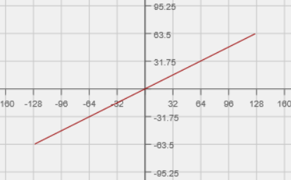
Bad Solution : v = kj
At first glance, adding a constant multiplier to the v = j relationship may seem a good ide ( v = kj ).
However, this will lower the top speed of the motor, since a joystick value of 127 does not translate to a motor speed of 127.
The graph shows v = 0.5 j. Clearly the maximum motor speed is inadequate.

Slide 9
A Better Solution : Polynomials
What if the relationship between v and j were non-linear? Quadratic?
Suppose v = j ². As j , the joystick assignment, increases from zero to 127, v , the motor speed, increases slowly at first but then rapidly grows – producing the desired effect.
Problem: v(127) does not equal 127 (rather, 127 ² or 16,129). v(127) has to equal 127 to retain maximum speed.
Solution: introduce a scaling constant k so that v(127) = k(127)² = 127

Slide 10
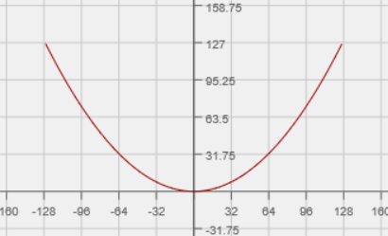
A Better Solution : Polynomials
In this example v = k(j)² , k should equal (1/127).
However, there is still a major problem. What? (Look at the negative – j regions of the graph).

Slide 11
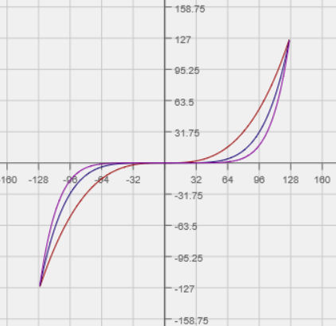
A Better Solution : Polynomials
A negative joystick input should not result in a positive motor speed!
The graph should be cubic in shape.
There are two possible theoretical solutions:
Use an odd power of j so that the graph is cubic.
However, higher powers produce situations in which the low-speed limiting effect is extremely pronounced.

Slide 12
A Better Solution : Polynomials
Alternatively, use two functions (piecewise). One function applies for positive values of j, and the other applies for negative values.
This is the more versatile solution since any power can be used, rather than only odds
v =

Slide 13
ROBOTC Implementation

Slide 14
ROBOTC Implementation
ROBOTC handles exponents as such:
Examples: What does each example mean?

Slide 15
ROBOTC Implementation
Example 1: If the desired power is odd, the motor speed assignment does not need to account for negative joystick inputs
A negative input will yield a negative output (unless if the power is even).
This code reflects $v= \frac{1}{16129}j^{3}$

Slide 16
ROBOTC Implementation
Example 2: Coding this relationship using if-statements to express the piecewise function necessary for even powers of j. The code reflects tank control programming.
v =

Slide 17
ROBOTC Implementation
This example may be refined with a return value function.
These functions, when called, calculate a number and “return” that value to the Cortex, substituting it in place of the function declaration.
For an integer return, the return function is declared and structured as such:
int functionName (int inputVariable)
{
int returnVariable;
… (Do stuff to find “returnVariable” from “inputVariable”)
return returnVariable;
}

Slide 18
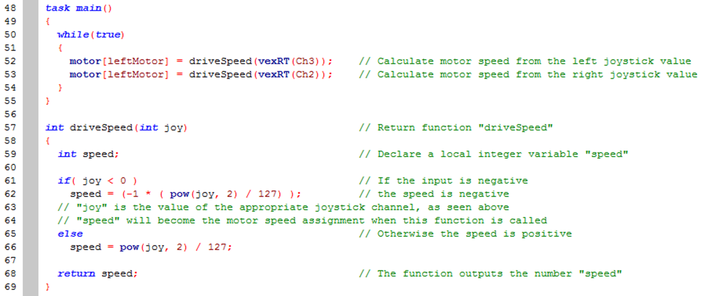
ROBOTC Implementation
Example 3:

Slide 19
ROBOTC Implementation Theory Revisited
Upon close inspection, it seems that the value of k is equal to one over 127 raised to one less than the power of j.
$v=\left(\frac{1}{127}\right)j^{2}$ or $v={\left(\frac{1}{127}\right)}^{2−1}j^{2}$, $v\left(127\right)=127;$
$v=\left(\frac{1}{16129}\right)j^{2}$ or $v={\left(\frac{1}{127}\right)}^{3−1}j^{3}$, $v\left(127\right)=127;$
Therefore, this is true:
$$v={\left(\frac{1}{127}\right)}^{n−1}j^{n} , v\left(127\right)=127, n>0$$

Slide 20
ROBOTC Implementation
Thus, in ROBOTC a constant integer may be utilized to store the power (n in the previous equation) for ease of modification.
The combination of this variable technique and the return value function (Example 2) provides the greatest versatility for polynomial motor speed control.

Slide 21
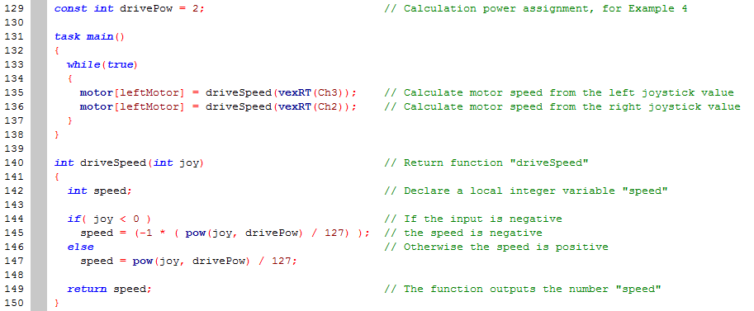
ROBOTC Implementation
Example 4 :

Slide 22
Conclusion

Slide 23
Sample Code
The code snippets within this presentation were taken from “Polynomial Chassis Driver Control Examples” available on Damien Robotics websites or directly from Ray Sun.
Pinout:
“leftMotor” in motor port 2
“rightMotor” in motor port 3
Remember that vexRT(Ch3) is the value of the y-axis of the left joystick and vexRT(Ch2) is that of the right joystick.

Slide 24
Alternatives
Of course, a polynomial relationship between motor speed and joystick input is not the only option.
Piecewise lines, exponentials, etc. etc. etc.
However, the polynomial perhaps necessitates the least amount of Cortex memory.
Why does this matter? Isn’t the simple motor[] = vexRT() relationship fine anyway?
motor[] = vexRT() works. However, the non-linear relationship facilitates more precise robot control. In VRC, with rather small scoring object goals, this may be crucial for programming precision.

Slide 25
Additional Applications
The polynomial technique is applicable to other types of chassis and even any mechanism controlled by a joystick
Example: Sample holonomic drive code utilizing the same return value function. “joy_Y”, “joy_X”, and “joy_R” are variables declared elsewhere that store joystick values.

Slide 26
END

