Slide 1
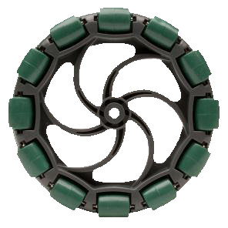
Chassis Design
Ray Sun
Damien High School Robotics
Mrs. Maricic
2016

Slide 2
Common Types

Slide 3
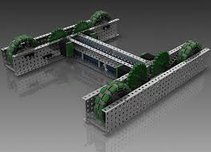
Standard Drive
Generally known as “tank drives” in the VRC world.
Usually constructed from four or six 4 inch wheels.
To aid with turning, the “outer” wheels are generally omni-directional. If a chassis is too long and the outer wheels are regular ones, the chassis will have poor turning
In this example, power is transmitted from motors to wheels by a chain system (chain not shown)

Slide 4
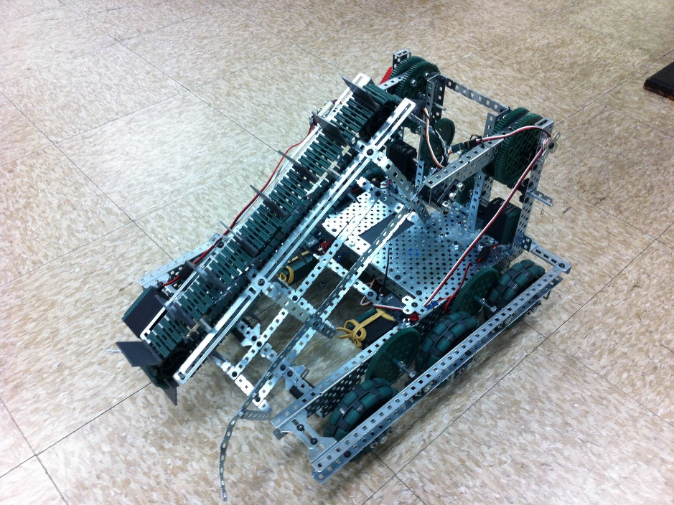
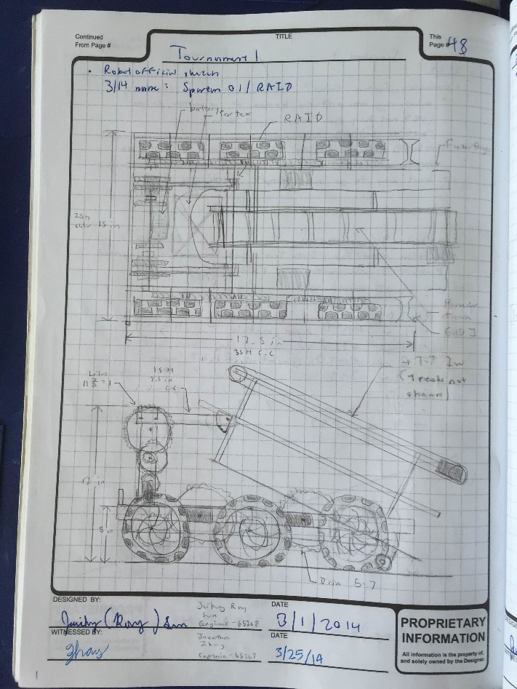
Standard Drive: DHS Team 6526D (VRC Toss Up)
Four motors driving six omni-wheels, 84 tooth gears turning 60 tooth gears

Slide 5
Standard Drive
Advantages
Disadvantages
Very easy to build and program
Very adaptable (different wheel combinations, gearing, etc.)
Usually take up little space; much space is left in the center of the robot for mechanisms.
Cannot move side-to-side.
If only omni-wheels are used, the chassis can be pushed from the side by other robots.

Slide 6
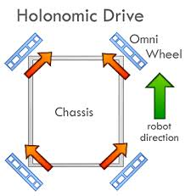
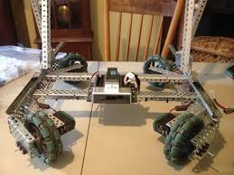
Holonomic X-Drive
“Holonomic” signifies a chassis’ ability to move in any direction, including side-to-side.
These chassis consist of four wheels arrayed 90 degrees from each other at the corners of a robot.
Is actually faster than a regular non-holonomic drive.
The wheels must be independently powered.

Slide 7
Holonomic X-Drive
Advantages
Disadvantages
Inherently faster than normal drives (vector sum)
Can move in any direction; therefore, very maneuverable
Push-resistant
Difficult to program and even more so to code effective autonomous routines.
Because the wheels must be offset at angles, difficult to attach external gear trains to motors
Somewhat fatter chassis segments than normal drives
Not as powerful as normal drives (less torque due to rollers)

Slide 8
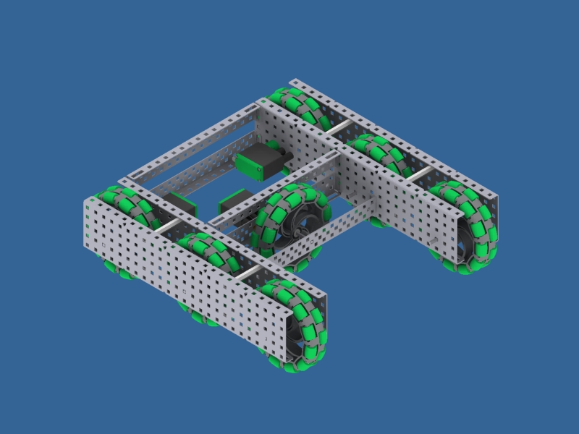
Holonomic H-Drive
This is simply a standard “tank drive” with additional omni-wheels installed in a middle section joining the two halves of the chassis.
All wheels must be omni-wheels.

Slide 9
Holonomic H-Drive: DHS Team 6526E (VRC Skyrise)

Slide 10
Holonomic H-Drive
Advantages
Disadvantages
Simpler to program than X-drives, since the wheels are not offset at 45 degrees
Holonomic capabilities
Very stable
Utilizes more motors (generally) than either tank drives or X-drives
No inherent speed benefit of X-drives
The center of the chassis is occupied, reducing space for mechanisms.
Heavy

Slide 11
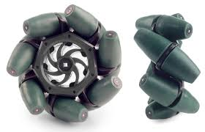
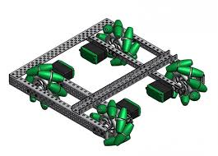
Mecanum Drive
This utilizes the VEX mecanum wheels in a normal four-wheel-drive configuration.
By reversing the direction of the motors, holonomic movement can be achieved
Each wheel must be independently powered

Slide 12
Mecanum Drive
Advantages
Disadvantages
Programming is very similar to X-drive programming.
Wheels are not offset (like those in X-drives). Thus the wheel mounts do not need to be offset 45 degrees.
Mecanum wheels are fat and heavy- chassis sides must be wide.
No inherent X-drive speed benefit
Motors are prone to overheating.

Slide 13
Less-Used Alternatives

Slide 14
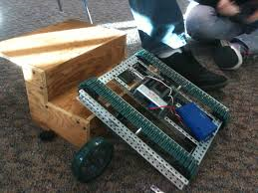
Tracked Drive
Rarely used in competition since tracked chassis are generally slower and have no practical benefits to competition goals.

Slide 15
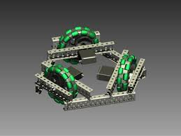
Triangular Holonomic Drive (“Kiwi Drive”)
Consist of three omni-wheels arrayed in equilateral triangle configuration
Rarely used in competition because of the difficulty in mounting scoring object manipulators on such a chassis.

Slide 16
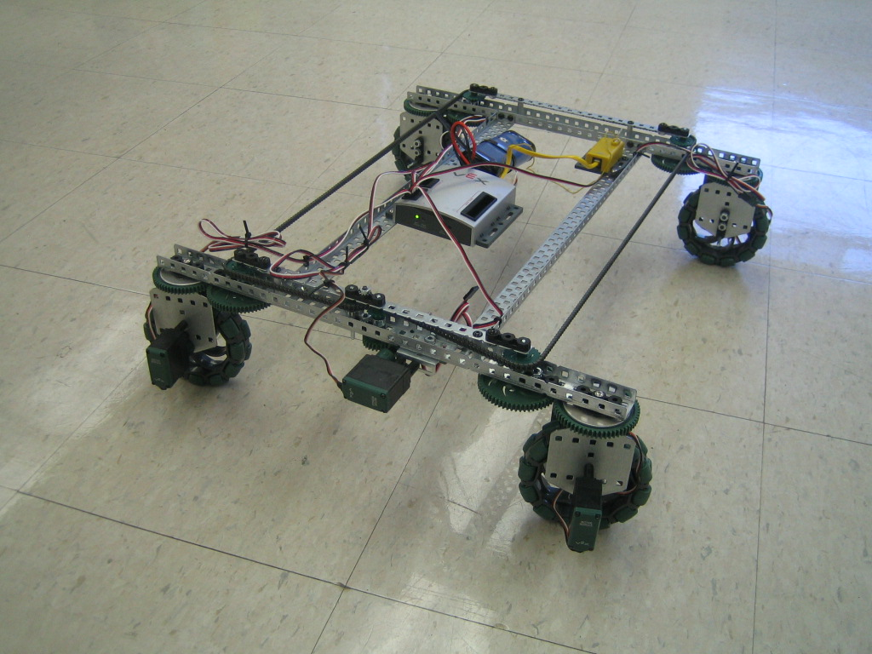
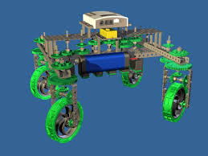
Swerve Drives
Consist of wheel pods that swivel
Not advisable for competition because of the extra motors needed to steer and the design’s clumsiness

Slide 17
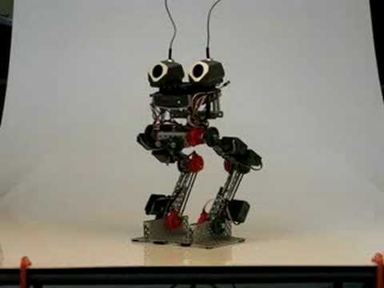
Legs?

Slide 18
Notables

Slide 19
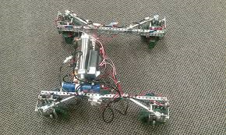
Shifting X-Drive (AURA, New Zealand)
Double-acting pneumatic pistons to shift wheel pods between X-drive configuration and standard configuration.
Therefore has advantages of both – the pushing strength of a tank drive and the maneuverability of a holonomic.

Slide 20
Shifting X-Drive (Team 2114A)

Slide 21
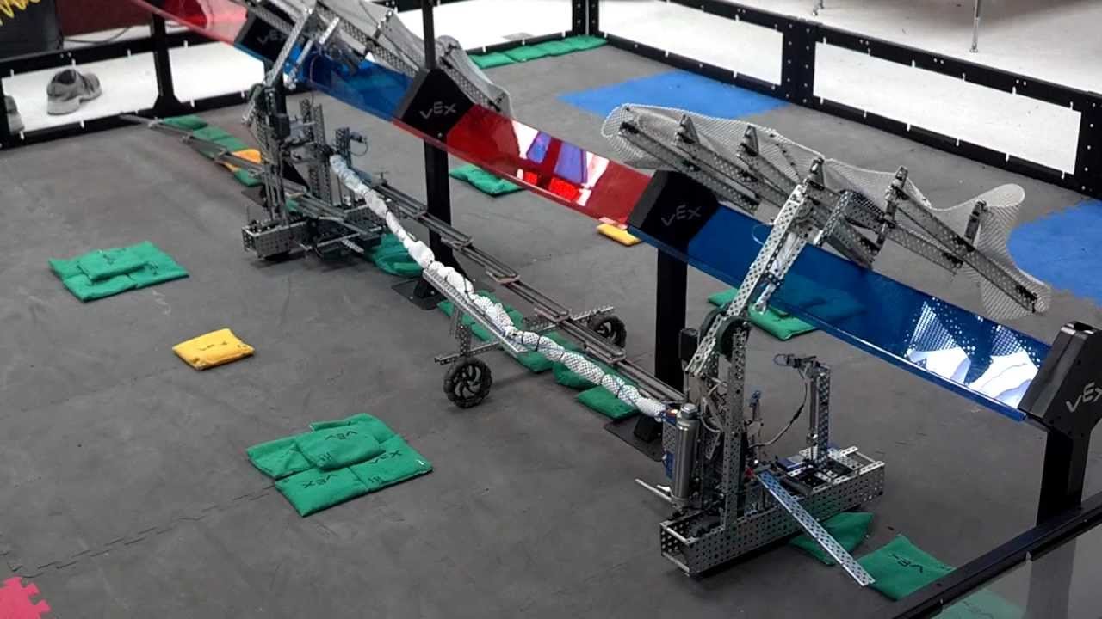
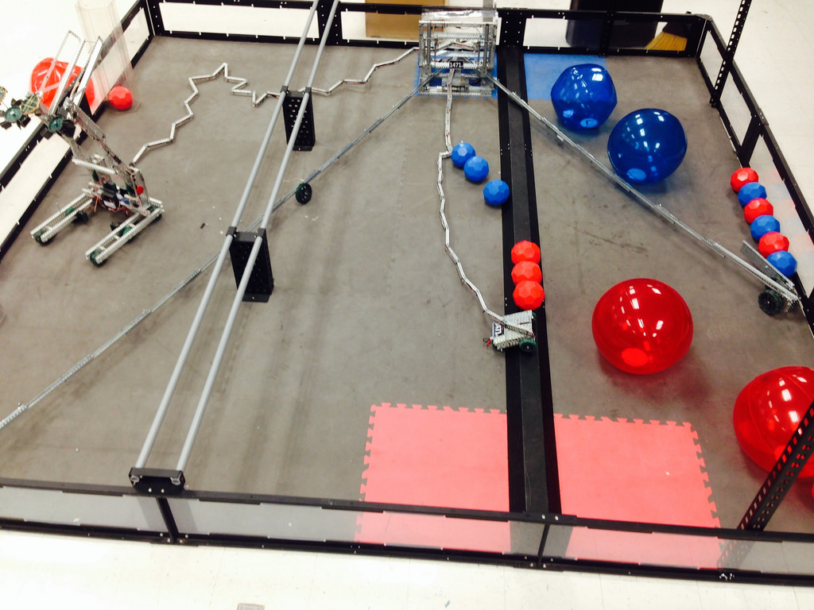
Wallbots
Chassis design varies with specific wallbot requirements.
Team 147A, VRC Toss Up
Team 147A, VRC Sack Attack

Slide 22
Design Considerations

Slide 23
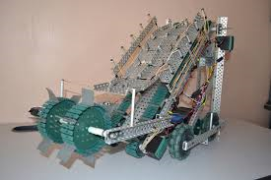
Mount Wheels Straddled between Metal Plates
Nearly all competition robots adhere to this principle: Support motor axles on more than one point!
Prevents motor overheat.
Prevents wheels from falling out if axle hardware loosens and also protects the moving parts.

Slide 24
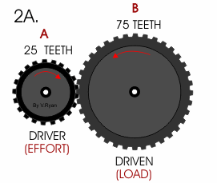
Gear Ratio
Gear ratio (GR) is the ratio of the number of teeth of the output gear (the one attached to whatever a motor is driving) and the input gear (the one attached directly to the motor)
Example: GR = 3
Why does this matter? There is an inverse relationship between driven gear speed and torque (roughly “ability to bear load”). You cannot have both.
Large GR: Low speed, high torque
Small GR: High speed, low torque

Slide 25
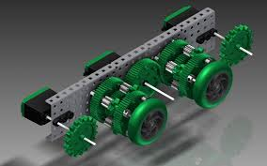
Gear Ratio
But what if I need both speed AND torque? Add more motors to the same gear system
If a low gear ratio (fast chassis, little pushing power) is desirable, the internal gears of the 393 motors may be swapped out:
Default (high torque) 100 RPM free speed (theoretical)
High speed gears 160 RPM free speed
Turbo gears 240 RPM free speed (Not recommended, very low torque; will overheat easily)

Slide 26
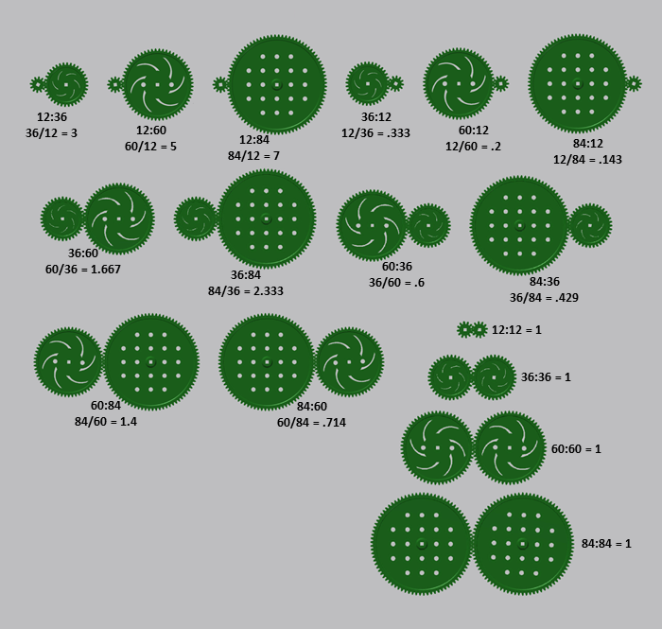

Slide 27
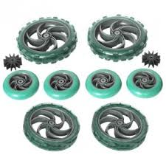
Wheel Size- Speed Versus Acceleration
Large wheels allow a robot to reach higher top speeds, but slow down its acceleration.
Small wheels equal quick acceleration, but low top speed

Slide 28
Four Inch Wheel Traction Comparison

Slide 29
How Many Motors?
Consider how heavy your robot is and its purpose in allocating motors to drive the chassis
For a standard non-holonomic drive,
For a lightweight robot or a largely stationary one, two motors may suffice.
If a robot is intended to push others (or will be involved in bot-to-bot fights over scoring objects), four or six motors are desirable.
For general purposes, four motors are good enough.

Slide 30
Concluding Advice
The VEX forums are an excellent resource. Teams frequently post pictures and videos of their robots in the “VEX Robot Showcase” section. Don’t be afraid to utilize ideas from the Internet.
Ask senior robotics members for build help and advice.
There is no right way to build. There is no wrong way to build. There are ways to build that will cause motor overheat, stripped gears, and bent metal, however.
Above everything else, keep the purpose of your robot in mind when designing your chassis.

Slide 31
END

